Slide 1

Python Project
TITLE: Music Player
Name: Naga Hari Mohan Rao N
Section: K23CH
Registration No: 12305203
Roll No: 36
Submitted To:
Aman Kumar

Slide 2
Overview of Music Player
Purpose
Music Player is a Python-based music player designed for simplicity and functionality.
Key Libraries
Built with Tkinter for GUI, Pygame for audio handling, and Mutagen for MP3 metadata.
Why Music Player?
It combines basic music player features in a lightweight and customizable application.

Slide 3
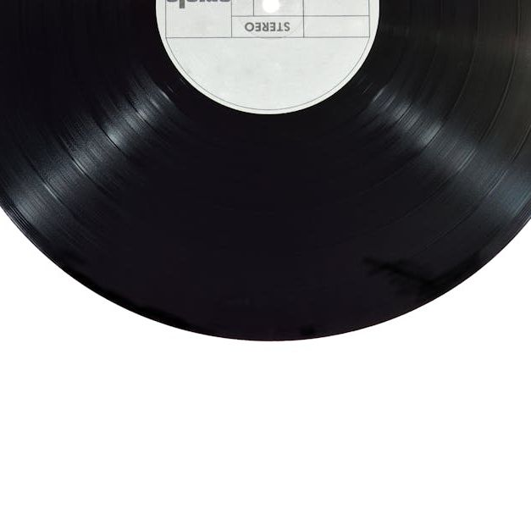
Key Features of Music Player
01
Playlist management with add/remove options.
02
Playback controls including play, pause, and rewind.
03
Volume control with mute/unmute functionality.
04
Displays song length and current playback time.
05
Themed GUI for an enhanced user experience.

Slide 4
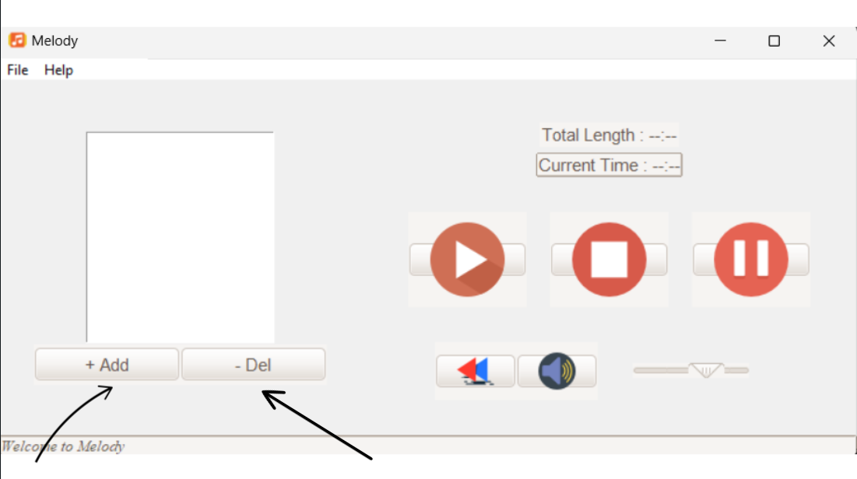
Playlist Management
Adding Songs
Use the file browser to select audio files and add them to the playlist.
Removing Songs
Select a song in the playlist and click the delete button to remove it.
Playlist Storage
Tracks are displayed with their filenames while paths are managed internally.

Slide 5
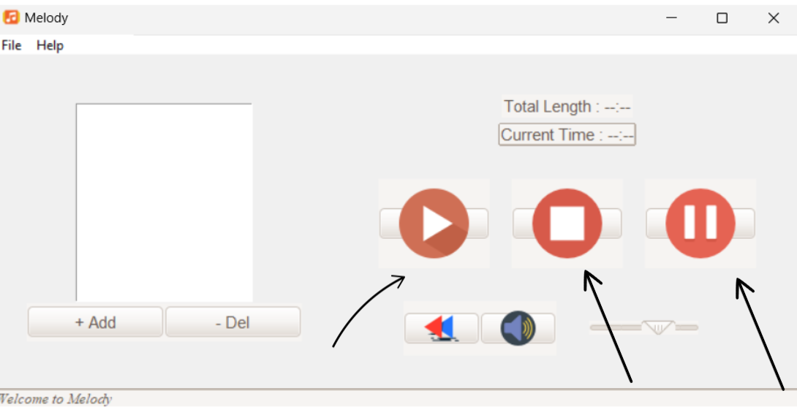
Playback Controls
Playing Songs
Select a song from the playlist and press play to start the music.
Pause and Resume
Pause playback at any time and resume from the same point.
Stop and Rewind
Stop the music or rewind to replay the track from the beginning.

Slide 6
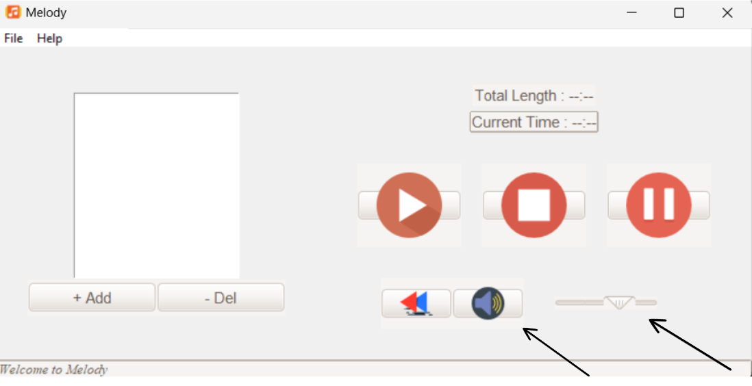
Volume and Mute Features
Adjusting Volume
Control the music volume using a slider that ranges from 0 to 100.
Mute and Unmute
Mute the audio with a single click and unmute to restore volume.
Default Settings
The volume slider is set to a comfortable level of 70% on startup.

Slide 7
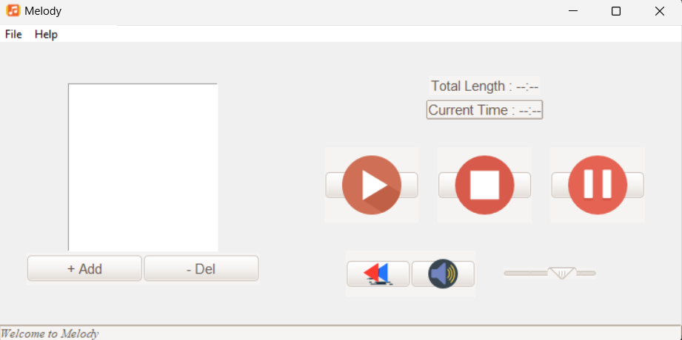
GUI Design
Layout
Organized into left and right frames for playlists and controls.
Theming
Employs Radiance theme for an aesthetic and user-friendly
interface.
Widgets
Uses Tkinter widgets for buttons, labels, sliders, and more.

Slide 8
Conclusion
The music player developed using Python and Tkinter demonstrates the power and flexibility of Python's libraries for creating interactive graphical applications. The project successfully integrates key features such as playing, pausing, stopping, and navigating through audio tracks, offering users a simple and intuitive interface to manage their music collection.

